Slide 1

Sales Pipeline Intelligence: From Data to Decision
Project Goal: Maximize Win Rate & Optimize Sales Resources
Presented
By
Elisha Bassey
Data Analyst | Turning complex data into clear, actionable business stories
Tools: Power BI | SQL | Python | CRM Pipeline Dataset

Slide 2
Powering Spota's Sales Growth: The Data Mandate
The Challenge: Spota is busy closing lots of deals, but we waste time on deals that are too small or likely to fail.
Project Goal: Use our sales data to help our team stop guessing and start focusing on the right deals at the right time.
The Main Questions This Project Answers
Descriptive Answer (The 'What'): Where do we win most often (countries/industries) and which agent/managers are the best at closing deals?
Predictive Answer (The 'How/Why'): Which active deals are currently most likely to fail, and what is the biggest process mistake we must fix to win more deals overall?

Slide 3
Methodology: How We Got the Answers
From Raw Data to Risk Scorecard
Source: Historical and Active Sales Deals from our central CRM database.
Key Information: Close Value, Agent/Manager, Account, Sector, Region, and Deal Stage
Size: Over 8,300 closed and active opportunities, excluding 500 prospecting deals
Stage | Tools Used | Purpose
Data Extraction & Cleaning | SQL | Extraction: Securely pulled the raw data and performed initial filtering.
Exploratory Data Analysis | Power BI | Visualization: Visualize trends, identify patterns, understand deal behaviour
Modeling & Evaluation | Python(Scikit-learn) | Modeling: Create features, build and train model for prediction and measure accuracy, precision, recall, f1-score and auc-roc
API Development | FastAPI | API: Create REST API endpoints for real-time Prediction
Containerization | Docker | Dockerisation: Parkage the model with all dependencies for consistent deployment

Slide 4
Executive Summary & Core Challenge
Pipeline Health: Strong Growth, But a Critical Problem
The Good News (What the Numbers Show)
Metric | Result | Trend
Win Rate | 63.15% | We close most of the deals we chase.
Opportunities | + 37% MoM | Our list of potential deals is growing.
Total Revenue | +12.8% MoM | We are making more money month over month.
The Critical Problem
Deal Size is Dipping ( - 0.8% MoM): We are celebrating many small wins, which is good, but it means we are spending too much time on low-value deals instead of big, important clients.

Slide 5
Key Descriptive Insights
Where We Win and the Best Performance
The Drivers of Success (Place and People)
Geography: The United States is the biggest source of revenue with over 45% of the total revenue.
Sector: The Retail Sector brings in the most value consistently, leading with over 1.4k opportunities
Talent: Hayden, Reed, and Darcel are the Tops number 1 Agents based on Success rate, conversion rate and most Revenue respectively.
Strategic Implication for Spota
Protect What Works: Keep focusing strongly on the US and Retail market.
Share the Knowledge: Find out exactly what our top agents do and teach it to everyone else to improve overall performance.

Slide 6
The Predictive Model as an Insight Engine
The Sales Risk Scorecard
Goal: We built a model to find Hidden Risks and Best Opportunities to fix our process.
Metric | Value | What It Means
Accuracy | ~66% | The model can't perfectly predict a win/loss alone.
AUC Score | 65% | The model is good at ranking deals by risk (high vs. low).
What the Model Delivers
It is a Risk Scorecard. It gives every active deal a score (0-100%) showing how much it looks like a deal we usually lose.
This score allows managers to decide where to focus their limited time and resources for maximum impact.
Bottom Line: Model is reliable enough to guide resource allocation decisions

Slide 7
PREDICTIVE MODEL - KEY FEATURES What Drives Deal Success? (Top Risk Factors)
DEAL DURATION (9.2%) 🔴 CRITICAL
Deals lasting >90 days lose 78% of the time
Average cycle: 48 days → Target: 40 days
Action: Flag stalled deals immediately
SALES VELOCITY (4.7%) 🟠 HIGH
Slow deals in large companies = more complex/risky
Action: Accelerate approval processes
SEASONAL TIMING (4.3%) 🟠 HIGH
Q4 deals 1.2x riskier than Q1
End-of-year urgency creates different dynamics
Action: Adjust Q4 strategy
AGENT PERFORMANCE (3.7%) 🟠 HIGH
Individual agent skill is highly predictive
Top agents: 70%+ win rate vs. Average: 62%
Action: Systematise top agent techniques
PRODUCT WIN RATE (3.0%) 🟠 HIGH
Product success varies: GTX Basic 64% vs. GTK 500 42%
Action: Match best agents to strong products
The Bottom Line: If you fix deal duration, you fix 9% of the problem. Focus on speed.

Slide 8
The Predictive Model as an Insight Engine
The Sales Risk Scorecard
PREDICTIVE RESULTS - ACTIVE DEAL FORECAST Risk Scorecard: 1,589 Active Deals Analyzed
Goal: We built a model to find Hidden Risks and Best Opportunities to fix our process.
Why So Pessimistic?
Model learned from historical data: only 63% win overall
Current pipeline shows same risk characteristics as historical losses
Many deals have warning signs: long duration, weak agents, weak products
Overall Prediction:
Predicted to WIN: 68 deals (4.3%) ✓
Predicted to LOST: 1,521 deals (95.7%) ✗
Metric | Value | What It Means
Accuracy | ~66% | The model can't perfectly predict a win/loss alone.
AUC Score | 64% | The model is excellent at ranking deals by risk (high vs. low).
What the Model Delivers
It is a Risk Scorecard. It gives every active deal a score (0-100%) showing how much it looks like a deal we usually lose.
This score allows managers to decide where to focus their limited time and resources for maximum impact.
Bottom Line: Model is reliable enough to guide resource allocation decisions
Confidence Level | Deals (N=1589) | Strategic Action
High (>70%) | 3 Deals | Trust: These deals are almost certain to close. Track them, but don't waste management time.
Medium (60-70%) | 974 Deals | Focused Review: Manager checks the Top 5 Risk Factors (Duration, Agent Skill, Product).
Low (<60%) | 612 Deals | RED FLAG INTERVENE NOW: These deals are our biggest risk. Immediately assign senior support to salvage or qualify out quickly.
Conclusion: The system tells us exactly where to put our most valuable resources to prevent the most likely losses

Slide 9
General Recommendations: A Strategic Roadmap
Combining Data: Three Pillars of Growth
Strategic Defence & Expansion (Descriptive)
  Action: Launch a "Defend the Dominance" campaign for the US and Retail sector, allocating additional marketing spend to protect our highest revenue stream.
  Goal: Secure market share and stabilise our revenue base.
Fix the Fundamental Flaw (Predictive)
  Action: Implement a Deal Duration Policy to flag any deal that sits idle past a fixed, short time window. Make "Stalled Deal" the number one metric for daily manager review.
  Goal: Stop losing deals to slow execution (our #1 risk factor).
Scale Talent and Best Practices (Descriptive + Predictive)
  Action: Document the entire sales process of our Top 20% Agents (identified by their high win rates) and turn it into the new standard training manual for all new hires.
  Goal: Reduce reliance on individual skill and institutionalise repeatable success across the entire sales team.

Slide 10
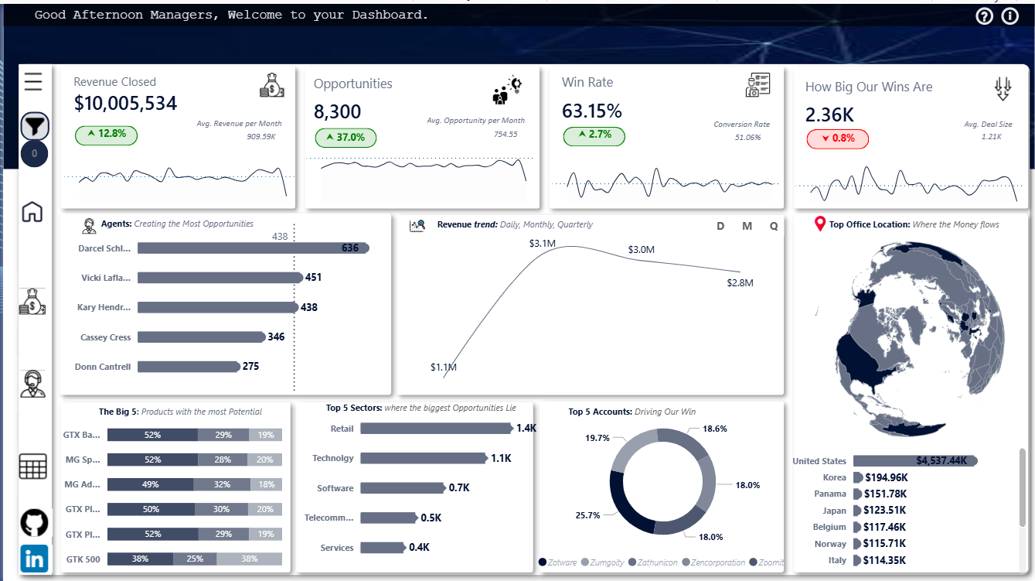
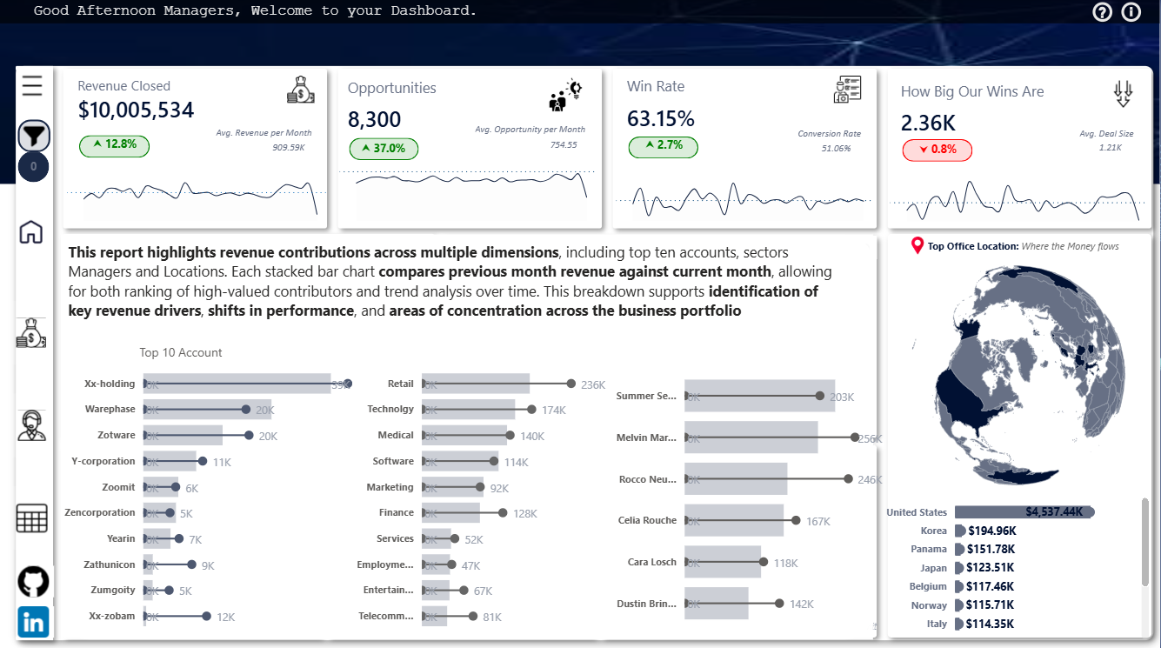
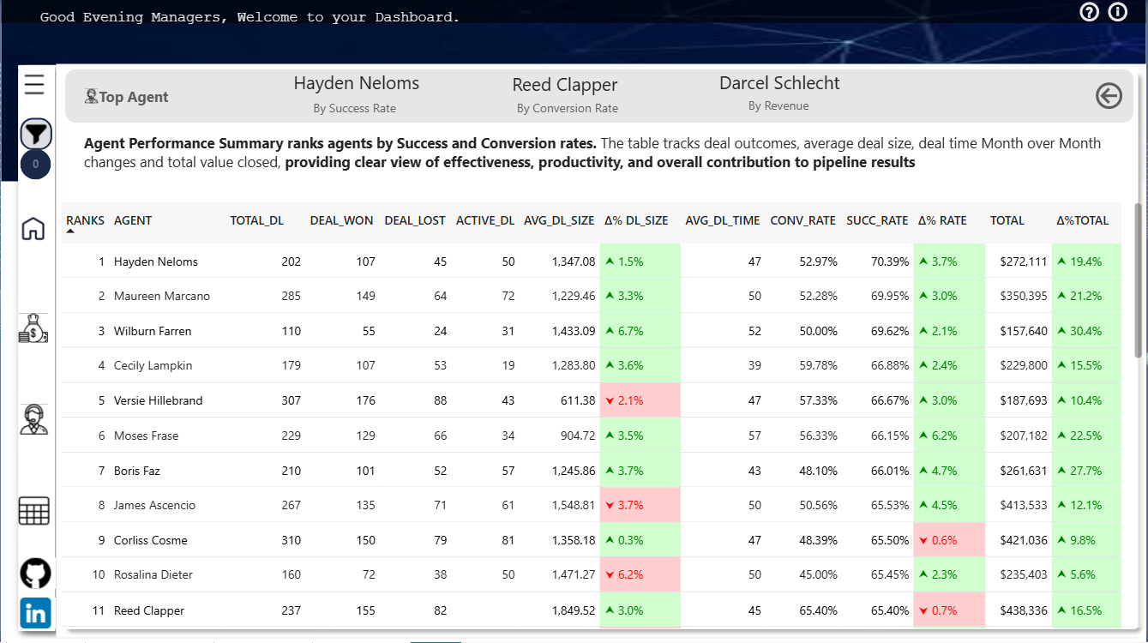
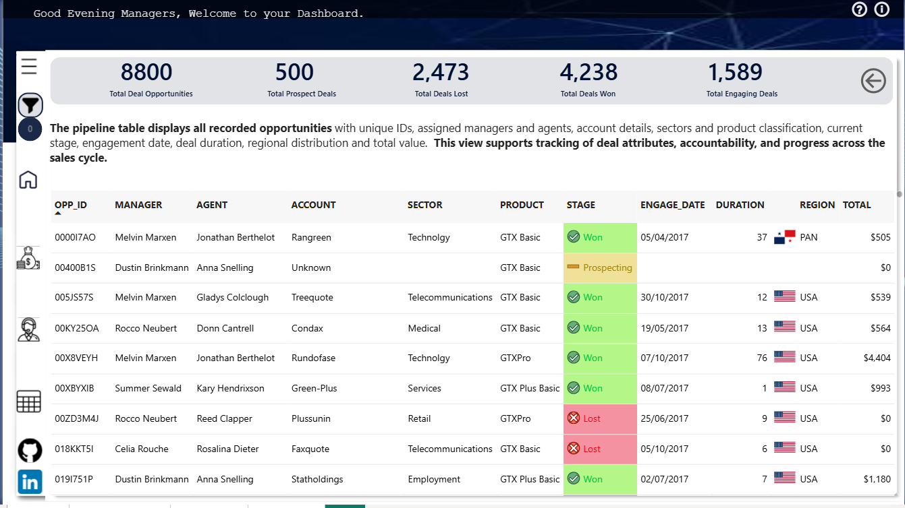
THANK YOU

Slide 12




echo "# Stage1-Backend-wizard" >> README.md
git init
git add README.md
git commit -m "first commit"
git branch -M main
git remote add origin https://github.com/Elice99/Stage1-Backend-wizard.git
git push -u origin main

